Slide 1
Competitive Analysis Portfolio
Shirley Lim
COGS 187A
HW#1

Slide 2
About myself
Keywords:
Linguist/ culture, minimalistic, child-at-heart
Dreamer
Runner/ one who perseveres

Slide 3
Starting off..
The next few schemes are personal portfolios of my friends.
In the reading, “How to Steal Like an Artist”, the author penned various anecdotes, such as “Nothing is original” and “Do good work and share with people”, I hope by comparing their personas that I know on personal level and one they want to be known on the web professionally.

Slide 4
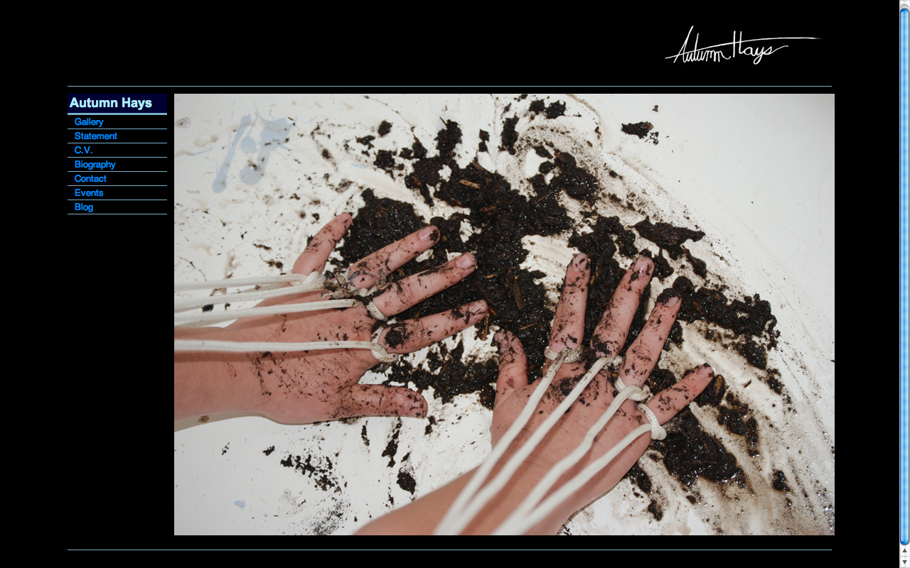
#1
Notes:
Site Name:
Site URL: http://www.autumnhays.com/
Date Looked at:
Layout: Featured Photo
Brand
Functionality
Interactivity
Navigation

Slide 5
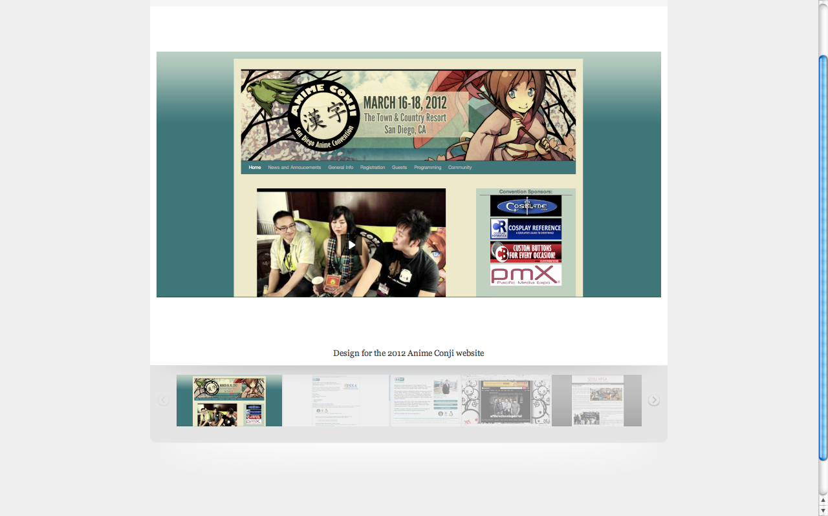
#2
Notes:
Site Name:
Site URL: http://myleneerpelo.carbonmade.com/projects/2053044#1
Date Looked at:
Layout: 3 Boxes
Brand
Functionality
Interactivity
Navigation

Slide 6
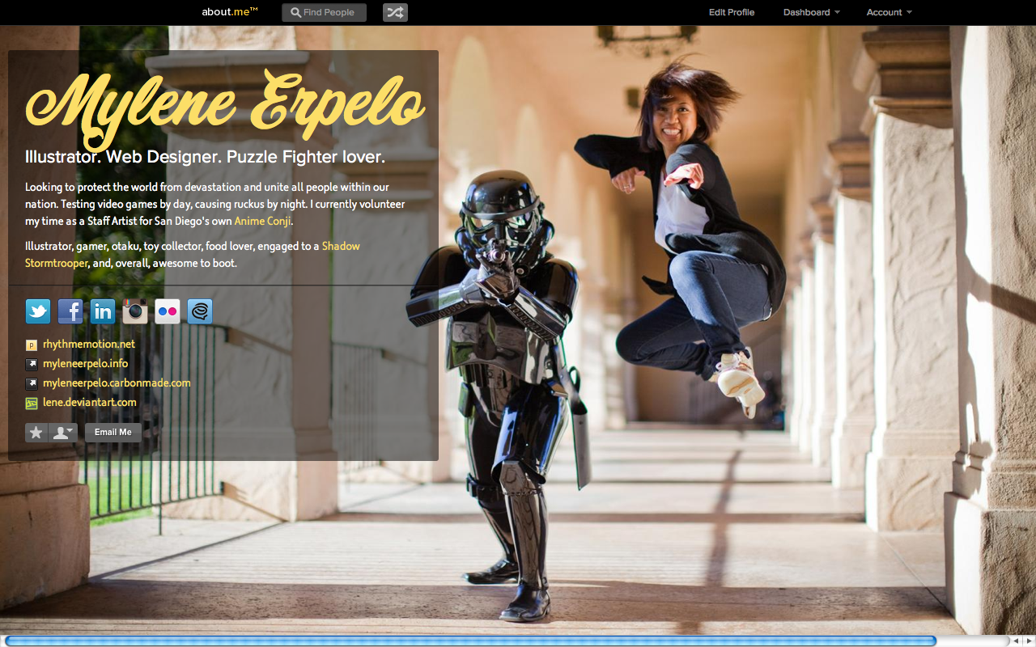
Notes:
Site Name:
Site URL: http://about.me/mylene
Date Looked at:
Layout:
Brand
Functionality
Interactivity
Navigation

Slide 7
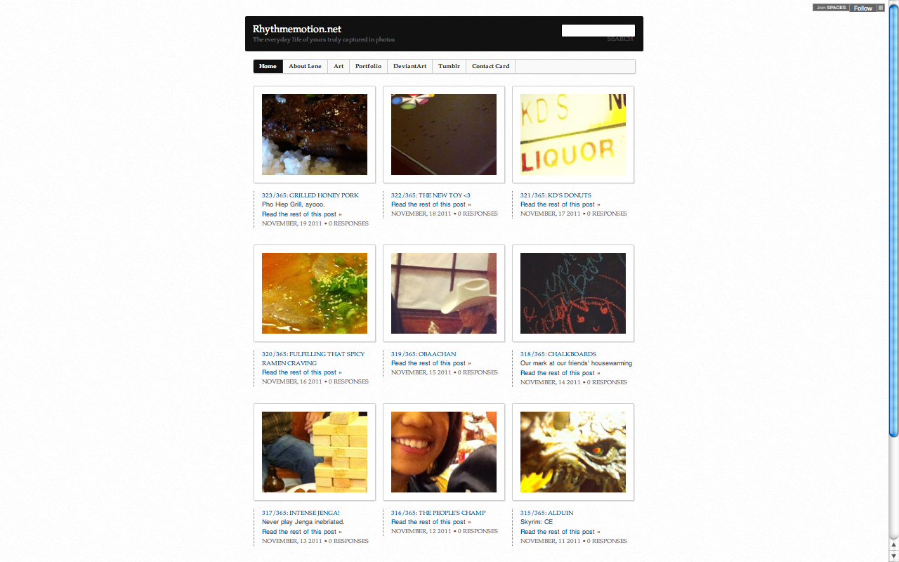
#3
Notes:
Site Name:
Site URL: http://rhythmemotion.net/
Date Looked at:
Layout: Headline and Gallery
Brand
Functionality
Interactivity
Navigation

Slide 8
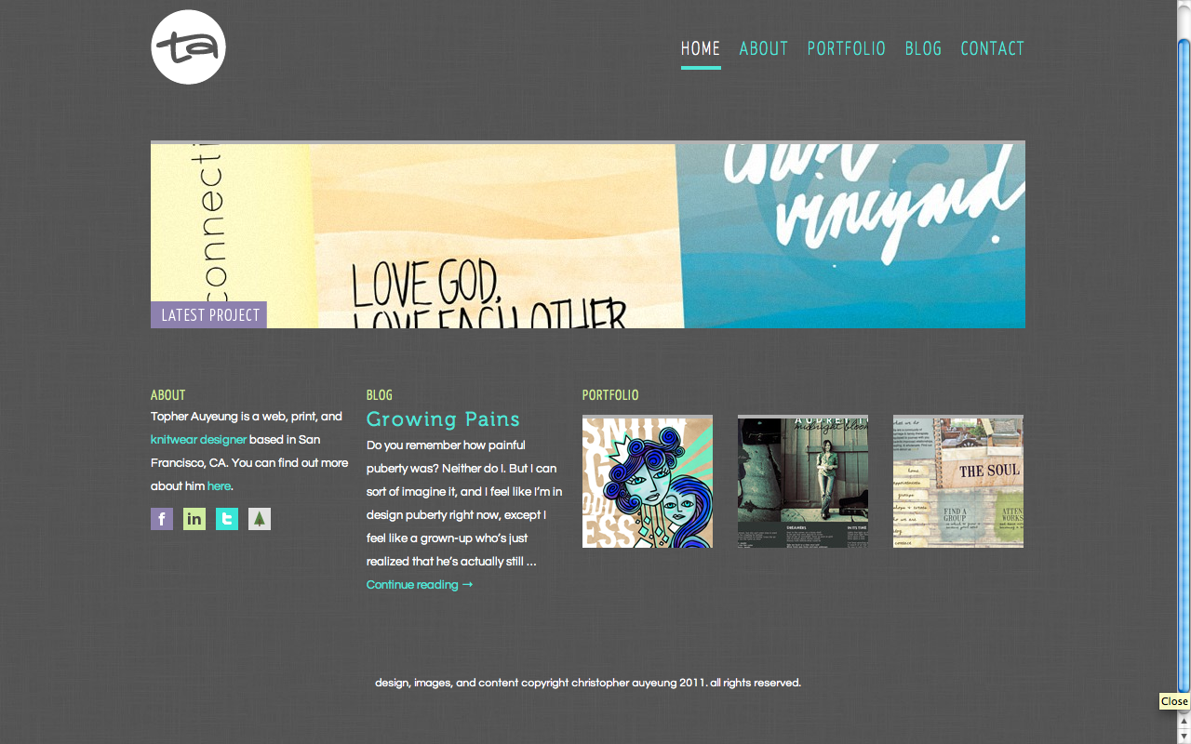
Notes:
Site Name:
Site URL: http://topherky.com/
Date Looked at:
Layout: 5 Boxes
Brand
Functionality
Interactivity
Navigation

Slide 9
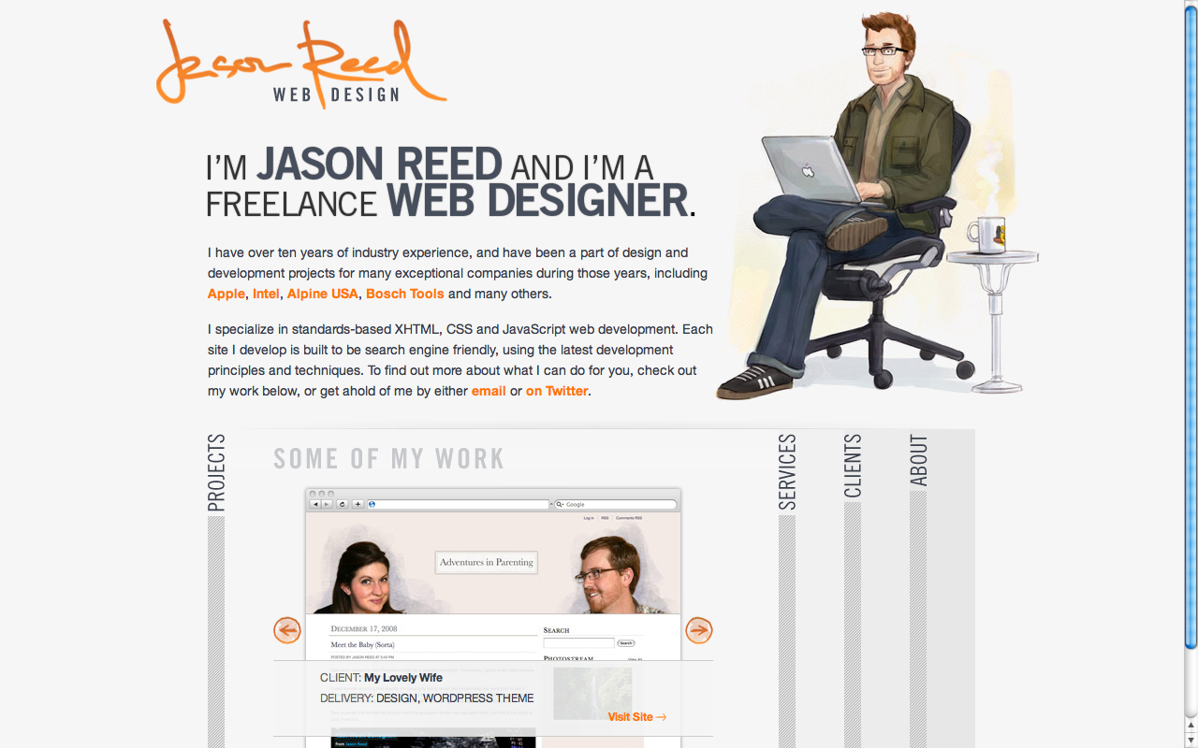
Notes:
Site Name:
Site URL: http://www.jasonreedwebdesign.com/
Date Looked at:
Layout:
Brand
Functionality
Interactivity
Navigation

Slide 10
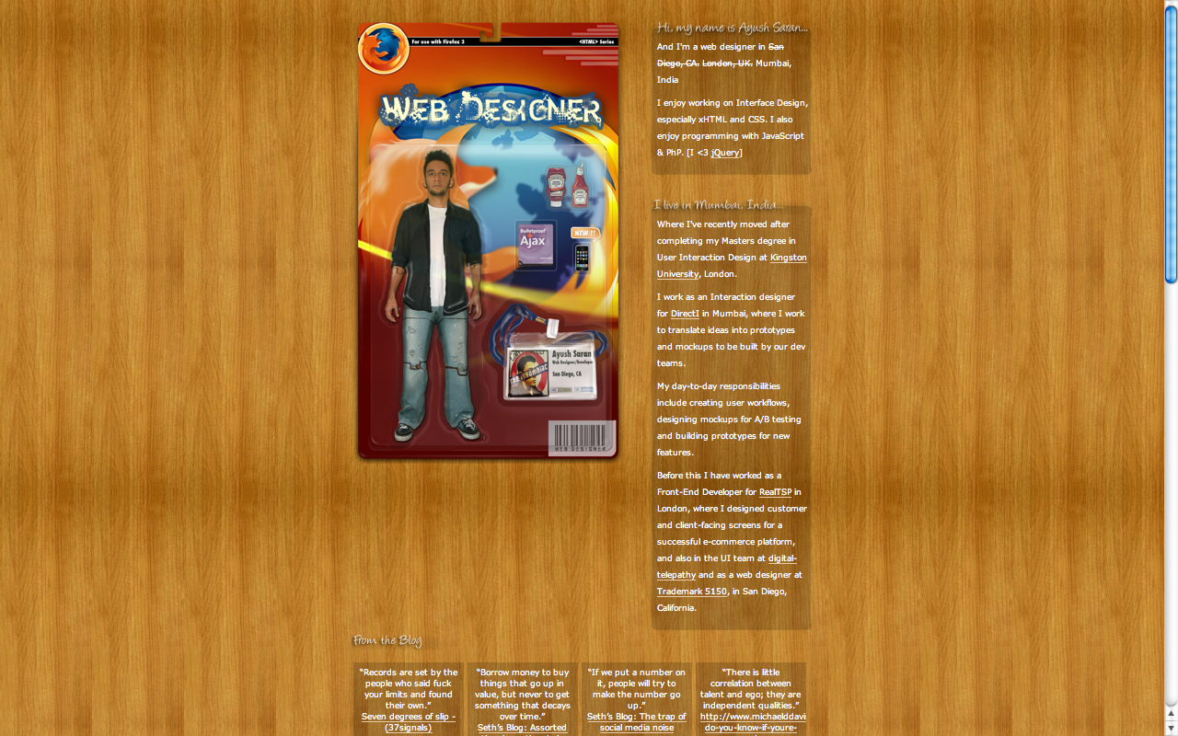
Notes:
Site Name:
Site URL: http://www.ayushsaran.com/
Date Looked at:
Layout:
Brand
Functionality
Interactivity
Navigation

Slide 11
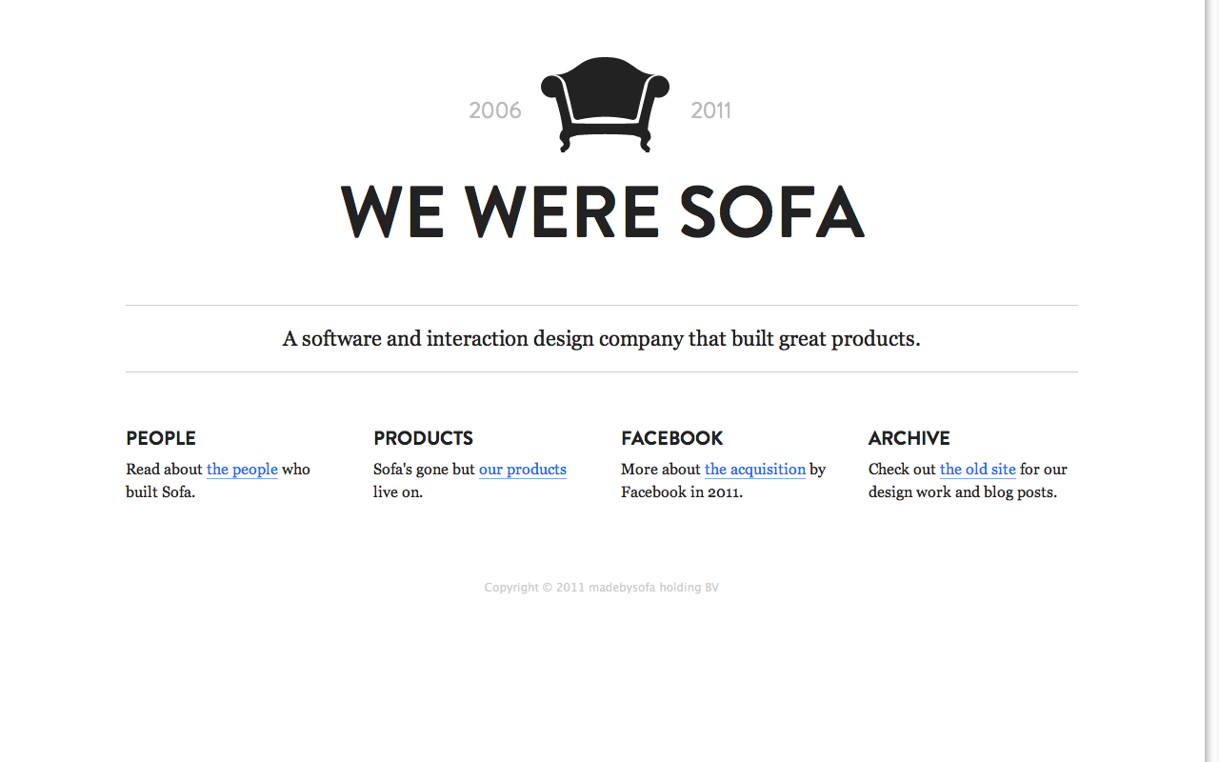
Notes:
Site Name:
Site URL: http://www.madebysofa.com/
Date Looked at:
Layout:
Brand
Functionality
Interactivity
Navigation

Slide 12
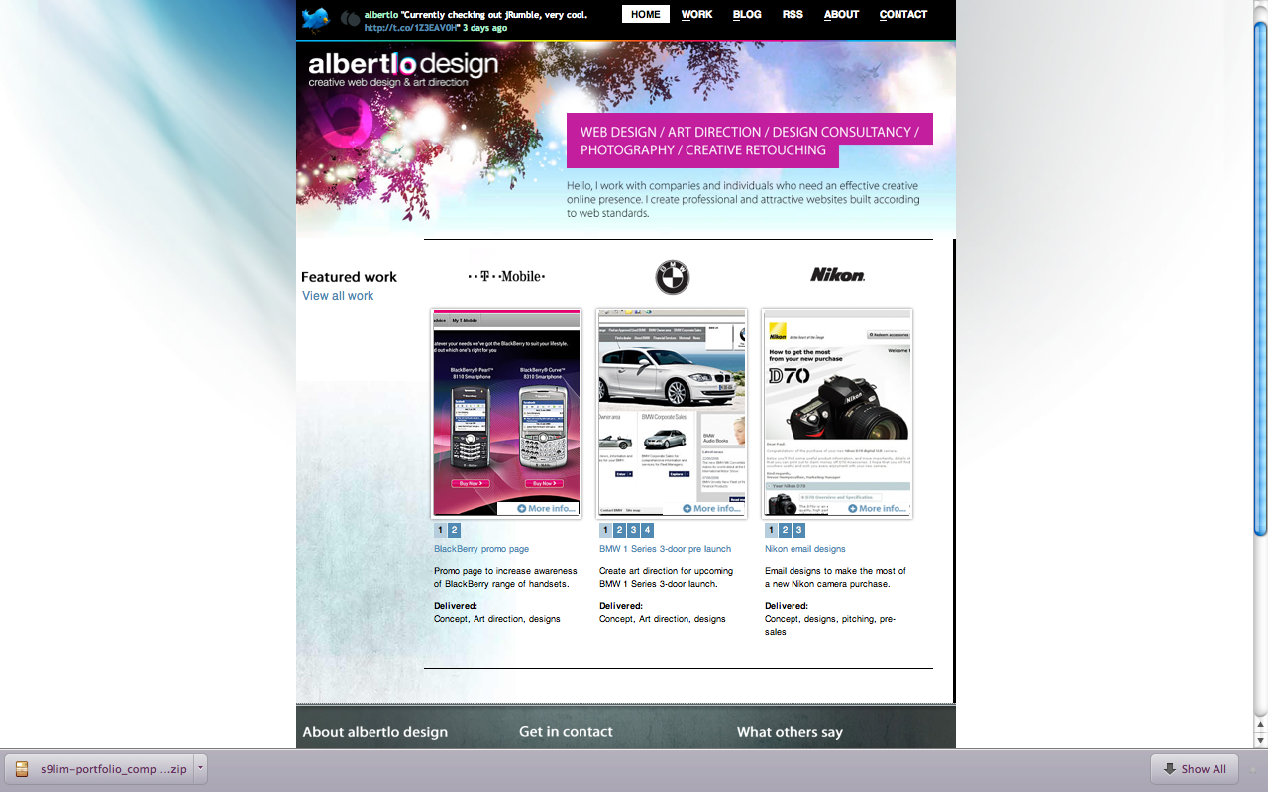
Notes:
Site Name:
Site URL: http://www.albertlo.com/
Date Looked at:
Layout:
Brand
Functionality
Interactivity
Navigation

Slide 13
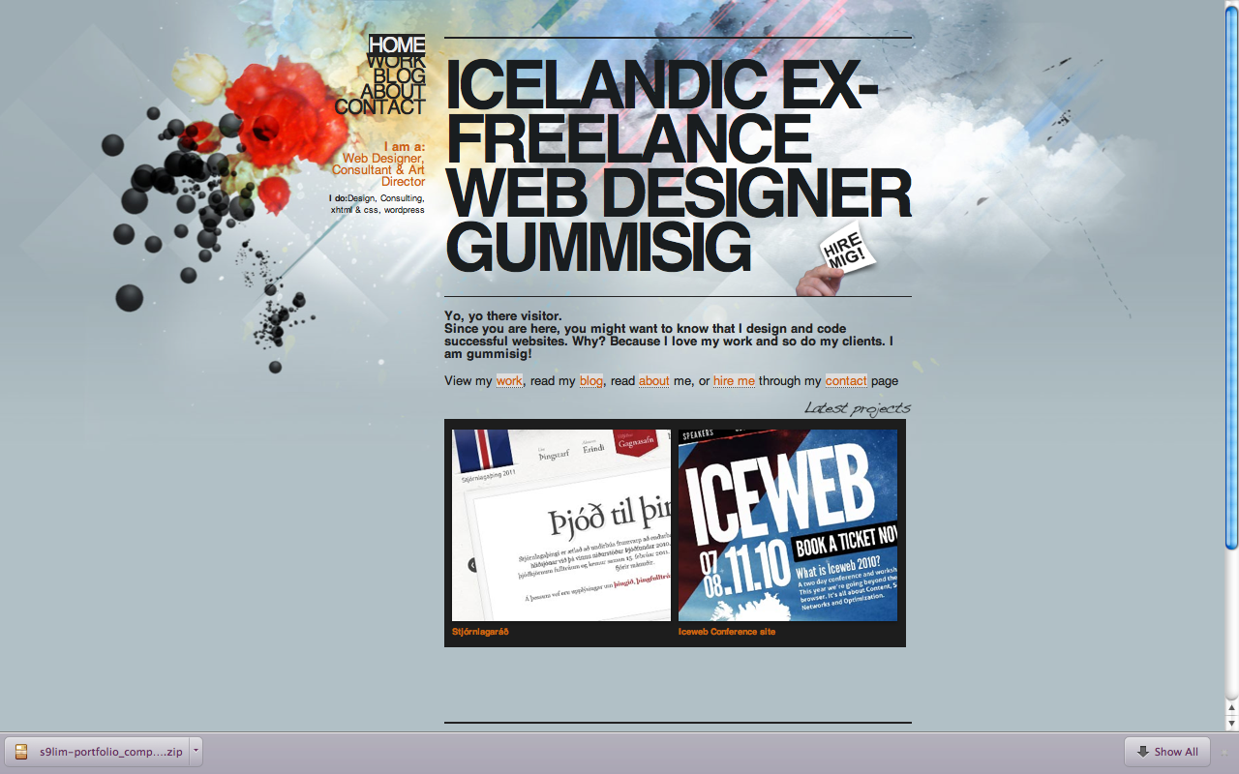
Notes:
Site Name:
Site URL: http://www.gummisig.com/
Date Looked at:
Layout:
Brand
Functionality
Interactivity
Navigation

Slide 14
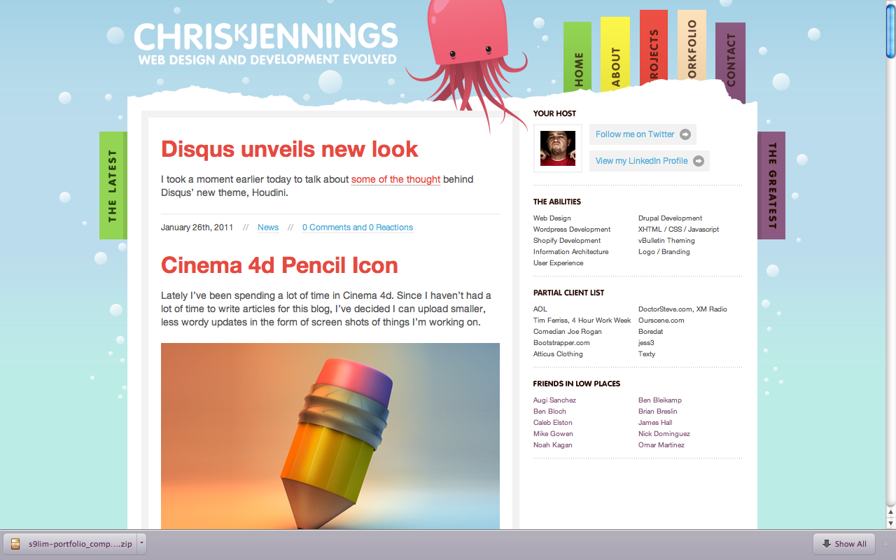
Notes:
Site Name:
Site URL: http://chrisjennings.com/
Date Looked at:
Layout:
Brand
Functionality
Interactivity
Navigation

